Slide 1




DATA ANALYTICS PROJECT ON IPL SCORE PREDICTION

Slide 2
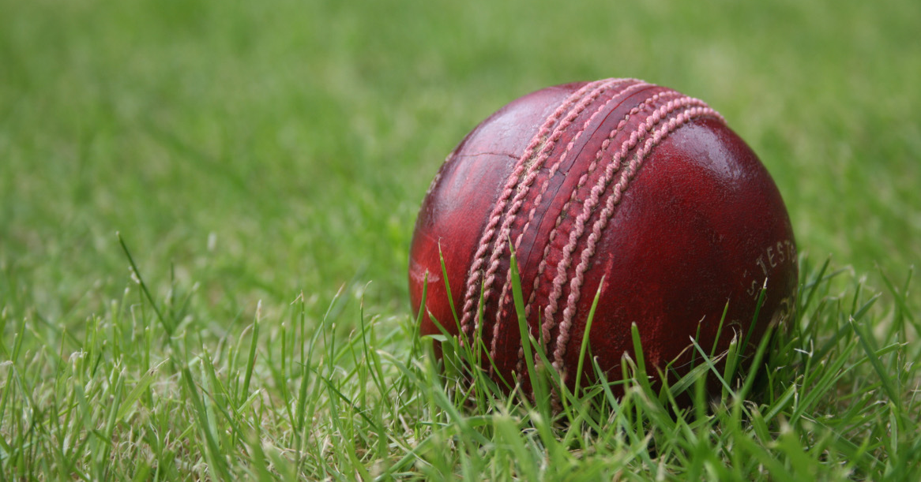
OBJECTIVE
The Project I have done is First Innings Score Prediction using Machine Learning.
This will Predict the Score of the First Innings by taking the overs, after 5 in order get the Overview of the Match.

Slide 3
BACKGROUND
Imported the Data Set.
Removing the unwanted Columns , First 5 overs and keeping the Consistent Teams.
Done One Hot Encoding.
Rearranging the columns.
Done Train and Test Split

Slide 4
WHAT YOU DID ?
Model Building using Machine Learning Algorithms.
Deployed the Code using Flask and Pickle.
Finally Displayed the PREDICTION using Some Interactive Webpages.

Slide 5
CONCLUSION
The Prediction is done by getting Inputs like Overs , Runs ,Wickets,Runs in last 5 overs and Wickets in last 5 overs.
Finally in the Result Page it Displays the Predicted Score of the First Innings.

Slide 6

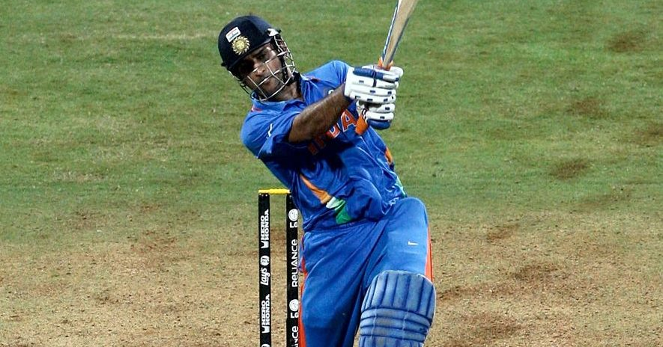

THANK YOU
Done By ASWIN N S

